Slide 1
Akshansh Agarwal Employee ID 4261
Excel Reassessment

Slide 2
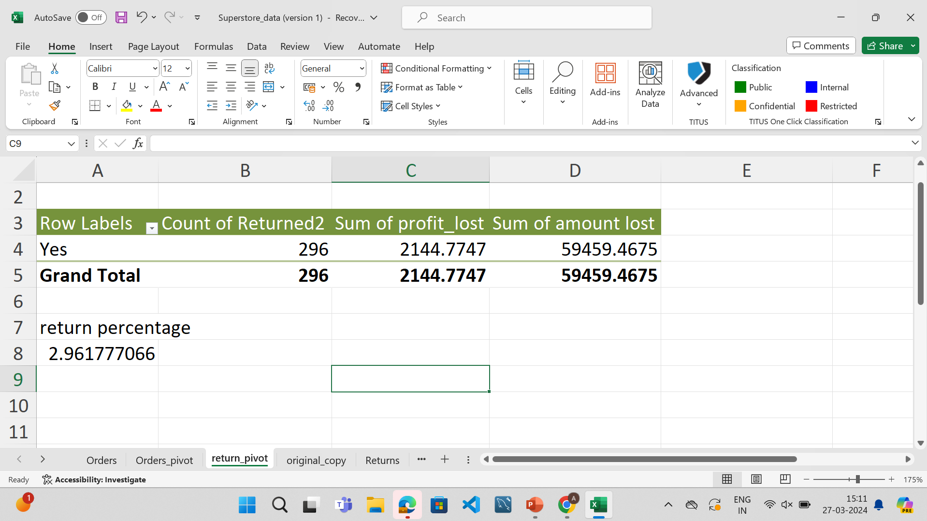
Q1
Amount lost due to returns = 59459.4675
Profit lost due to returns = 2144.7747
Return order percentage = 2.96%

Slide 3
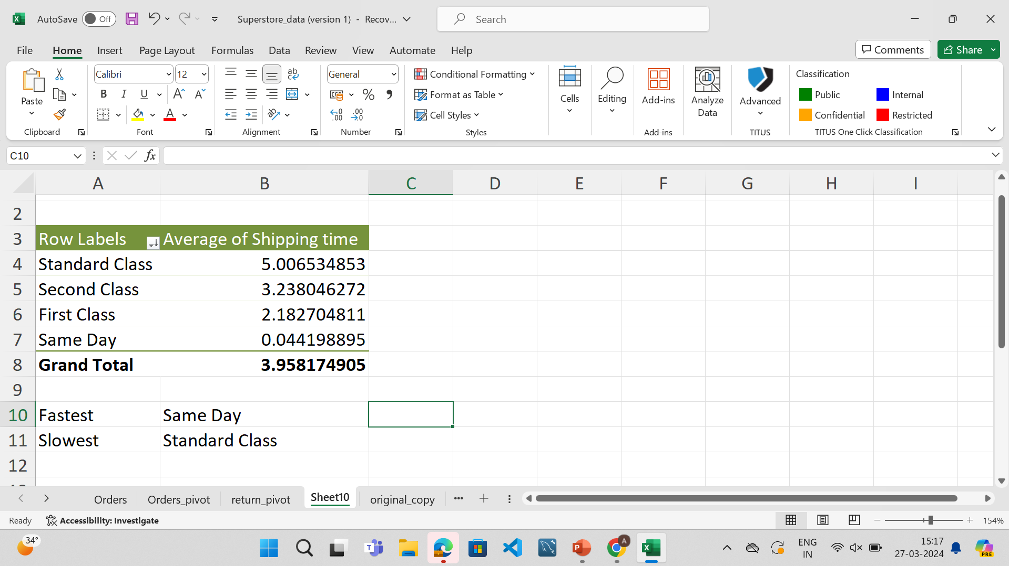
Q2
Fastest Shipping mode : Same Day
Slowest Shipping mode : Standard Class

Slide 4
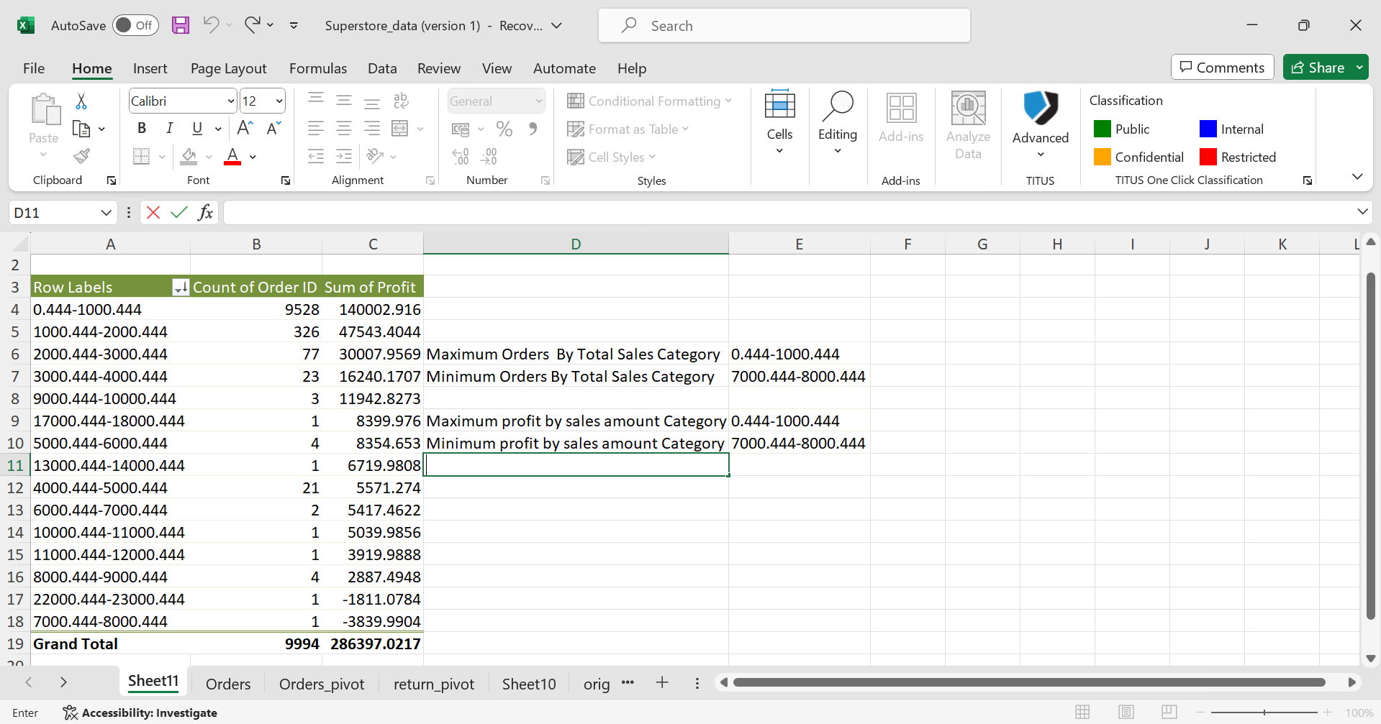
Q3
Maximum Orders are between By Total Sales Category = 0.444-1000.444
Minimum Orders are between By Total Sales Category = 7000.444-8000.444
Maximum profit by sales amount Category = 0.444-1000.444 total of 48% of profit comes from here
Minimum profit by sales amount Category = 7000.444-8000.444

Slide 5
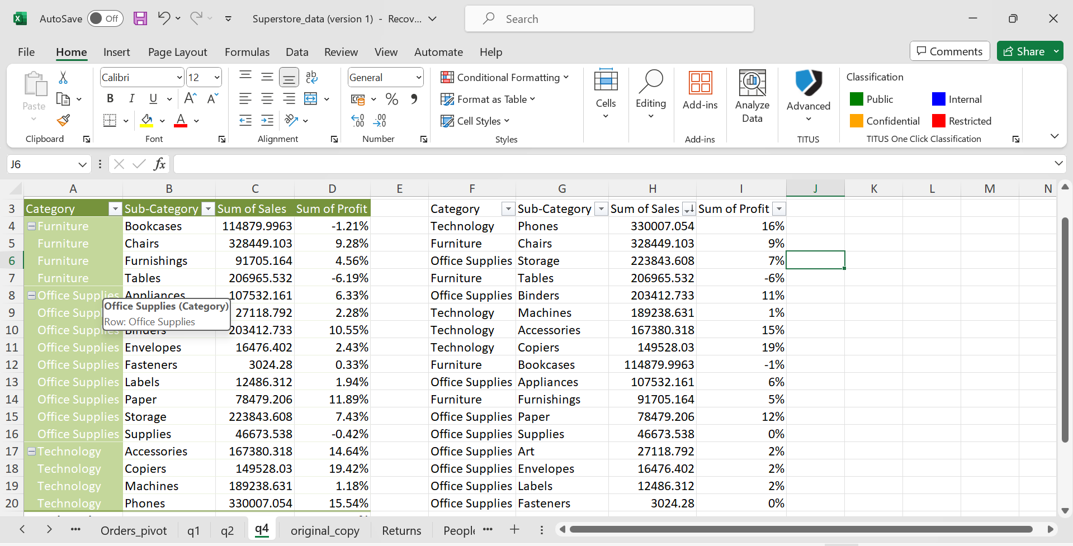
Q4
TOP 3 combination of category and sub-category and their profitability percentage based on total sales are
Technology | Phones | 330007.054 16%
Furniture | Chairs | 328449.103 9%
Office Supplies | Storage | 223843.608 7%

Slide 6
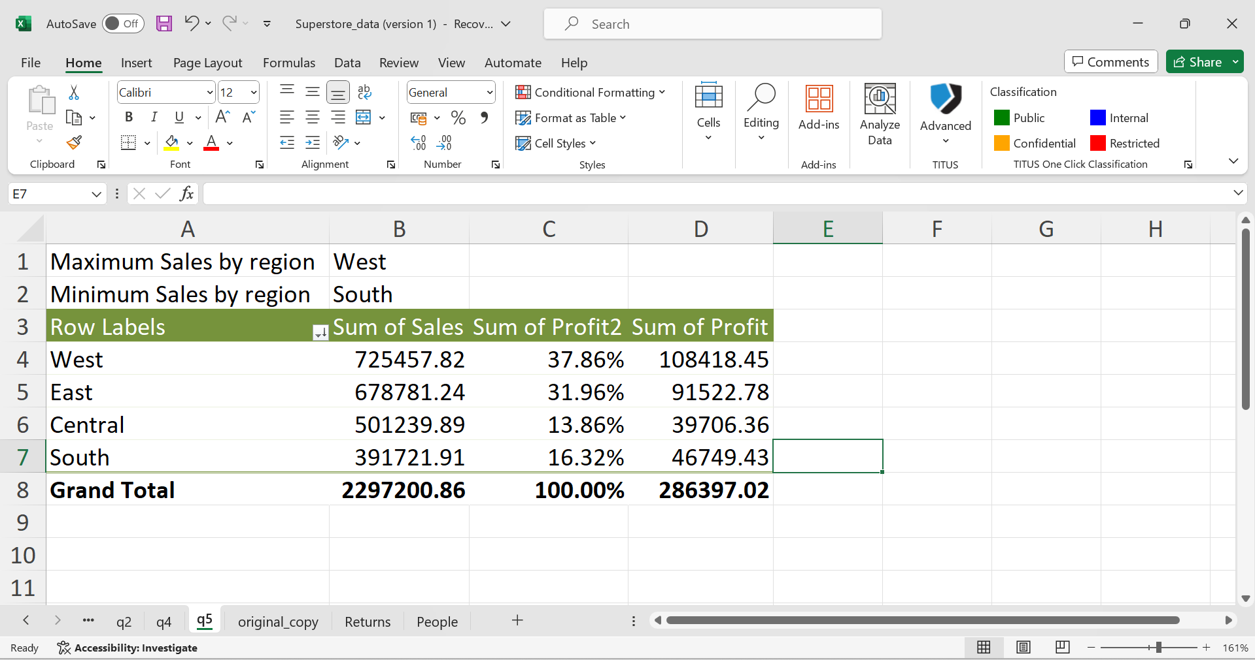
Q5
Maximum Sales are from region : West
Minimum Sales are from region : South
Maximum Profit is given by WEST region
Minimum Profit is given by Central Region

Slide 7
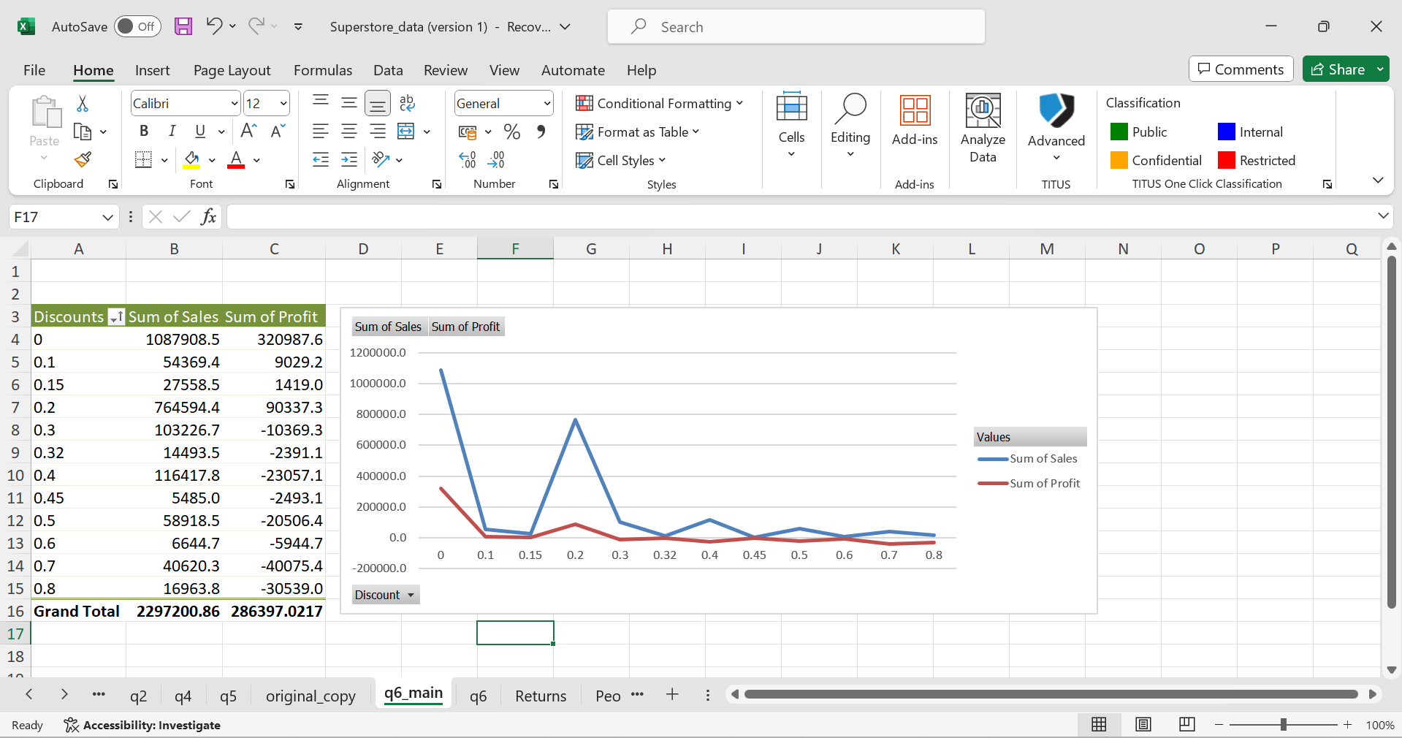
Q6
Correalation between discount rate and quantity : =CORREL(T2:T9995,S2:S9995) = 0.008623
Correalation between discount rate and quantity : =CORREL(A4:A15,C4:C15) ( this formula is from pivot table ) = -0.63123

Slide 8
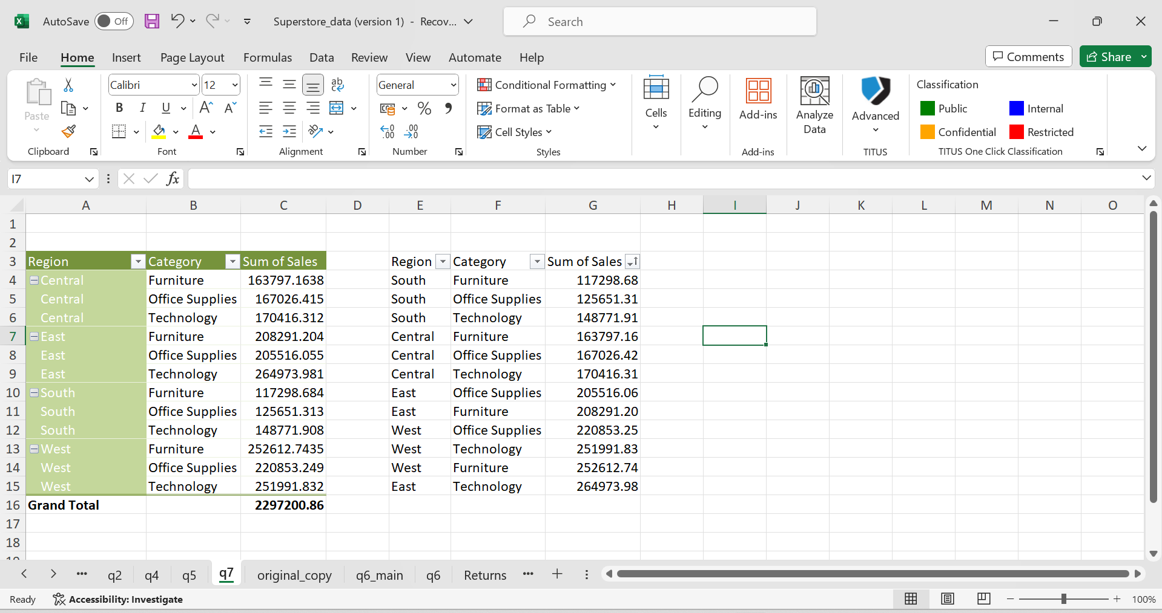
Q7
From the screenshot we can see that SOUTH region can be penetrated with Furniture as it has the lowest SOUTH region have lowest sales of furniture.
CENTRAL region can be penetrated with FURNITURE.
EAST region can be penetrated with office supplies.
WEST region can be penetrated with office supplies

Slide 9
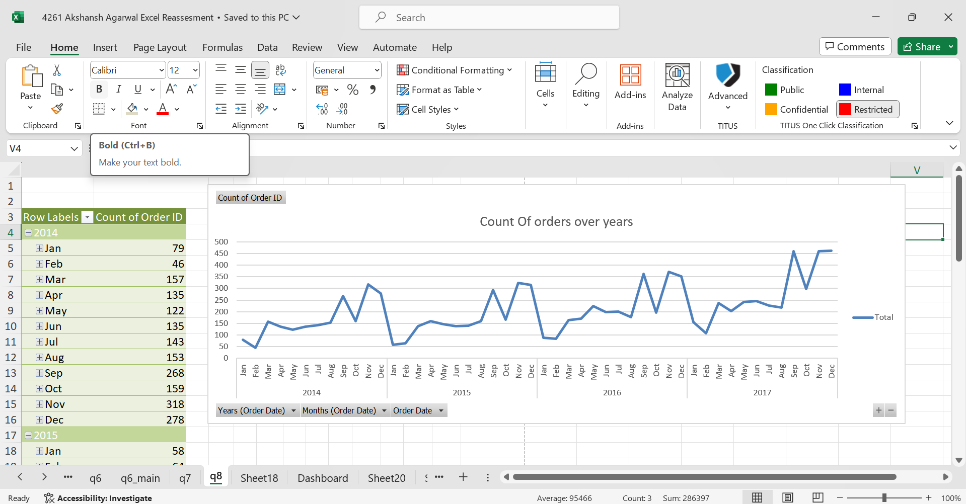
Q8

Slide 10
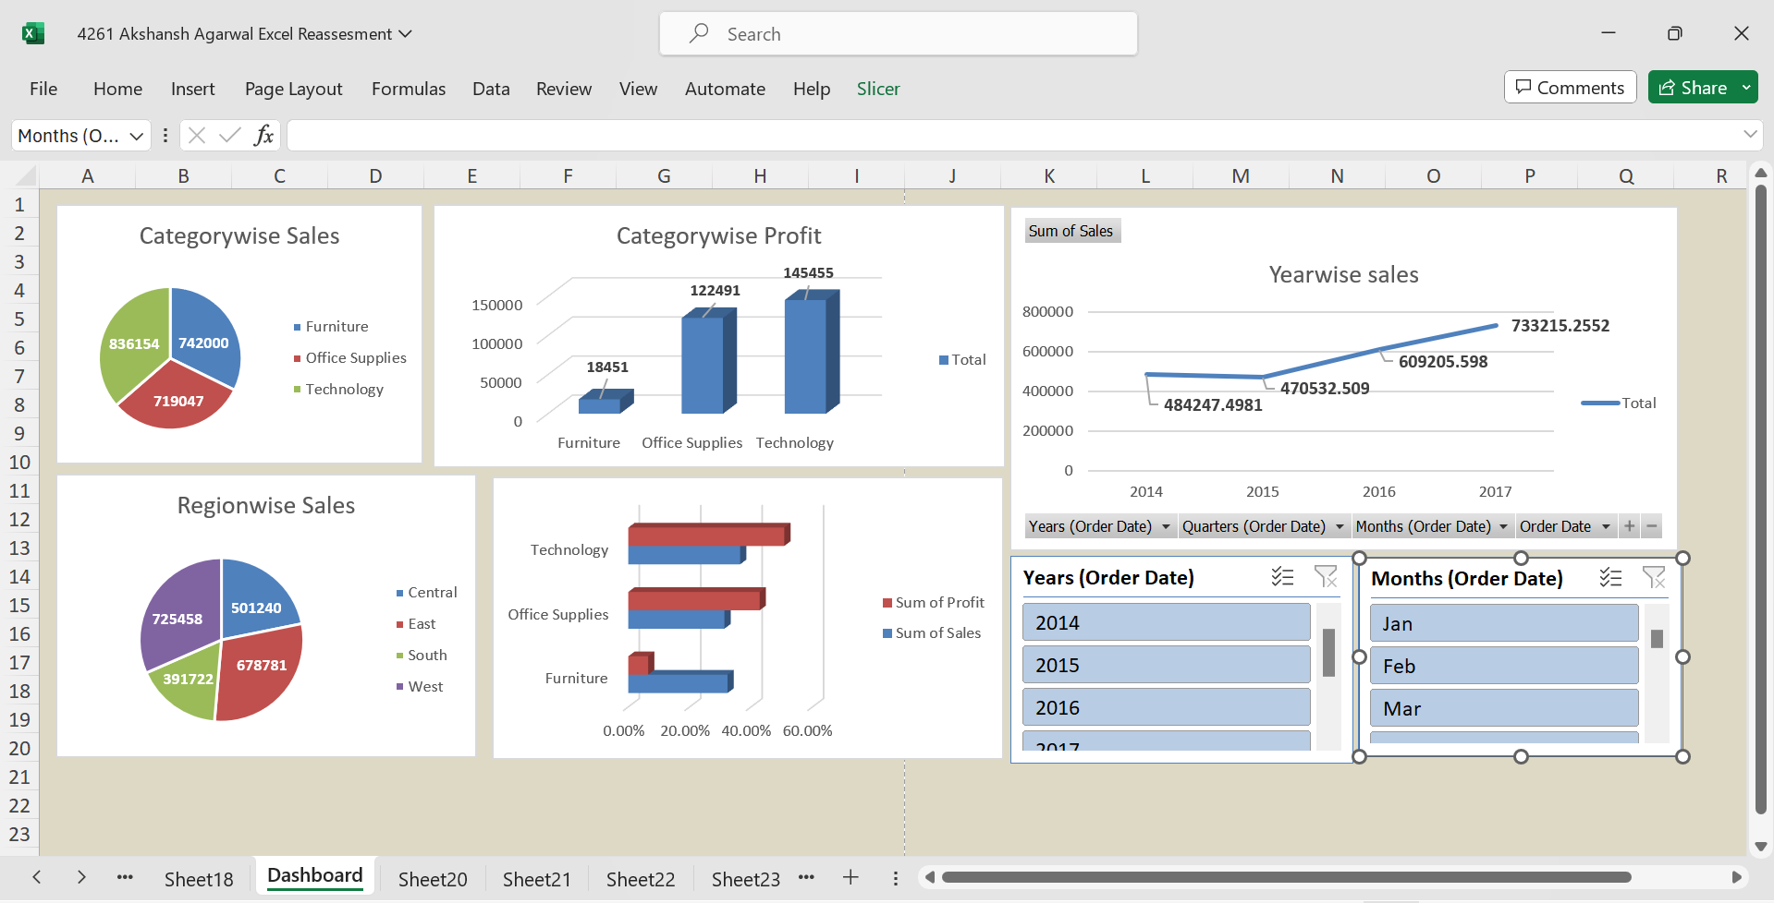
Dashboard : Sales and Profit Dasboard

